Slide 1
Endpoint Privilege Management and App Control for Business: Friends or Foes?
Jens Du Four
Notes:
In today’s rapidly evolving digital landscape, businesses face the dual challenge of empowering employees with the tools they need while safeguarding sensitive data and systems from potential threats. This session will explore the critical roles of Endpoint Privilege Management (EPM) and Application Control for Business in achieving a balanced security posture. We will delve into the intricacies of EPM, which enables rule-based elevation, and Application Control for Business, which helps prevent undesired apps from running on your managed Windows devices. Can these technologies work in harmony or will they bring chaos?

Slide 2





Jens Du Four
Cloud Endpoint Technical Specialist @ Microsoft BeLux
Teacher @ CodeFever
Crew Member @ MC2MC
Microsoft Certified Trainer
https://www.facebook.com/dufour.jens
https://www.instagram.com/jens.dufour/
https://www.linkedin.com/in/jensdufour/
https://jensdufour.be/
Notes:
Use this to add speaker bio

Slide 3




















PLATINUM
GOLD
SILVER
SPONSORS
EVENT PARTNERS

Slide 4
A brief recap of EPM

Slide 5

The elephant in the room…
Intune Suite
Add to Plan 1 to utilize these solutions*
Remote Help
Endpoint Privilege Management
Advanced Analytics
Enterprise Application Management
Cloud PKI
All Intune Plan 2 features
Prerequisite
Intune Plan 1
Intune Plan 1
Included in EMS E3 or Microsoft 365 E3, ME5, F1, F3, and Business Premium plans
Cross-platform endpoint management
Endpoint security built in
Endpoint analytics
App protection policies
Shared device management
Device compliance
Risk and app based conditional access
Proactive remediation
Integrated Microsoft 365 and security
Intune Plan 2
Add to Plan 1 to utilize these features
Tunnel for Mobile App Management
Mobile firmware update management
Specialty device management
Multiple managed accounts (future)
Prerequisite
Intune Plan 1
*Also available as individual add-ons
aka.ms/IntuneSuitePricing

Slide 6

What is the problem?
Running as a standard user reduces the attack surface…
Zero Trust Framework
Least Privilege Access
Impact on user productivity…
Standard users can’t do everything

Slide 7
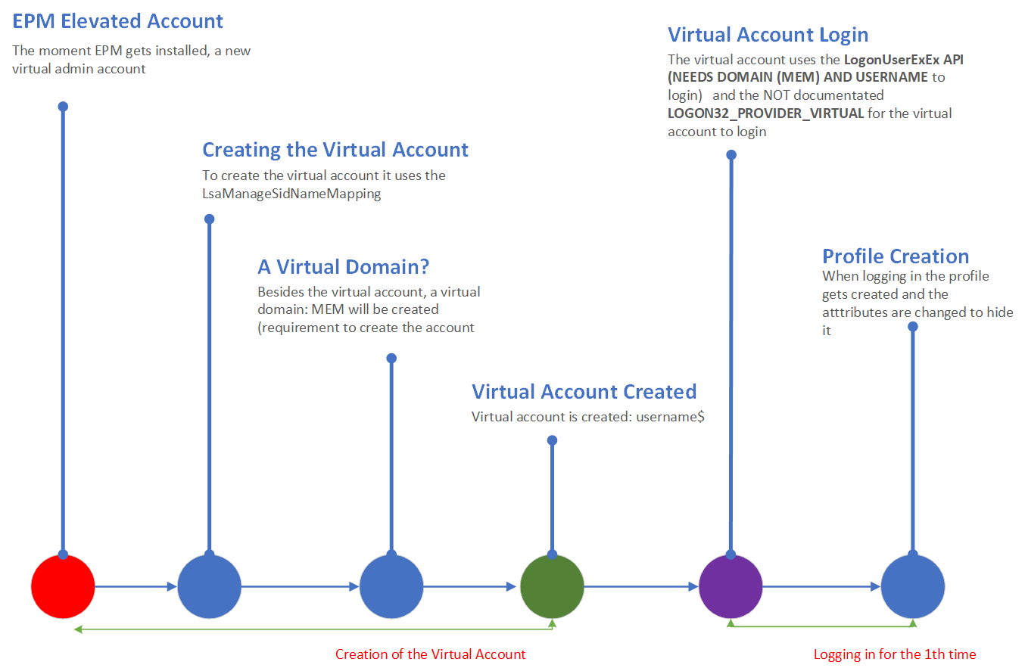
How does it work?
Source: Ooms, R. (2023, May 31). The Virtual Account that rocks the EPM! Call4Cloud from https://call4cloud.nl/virtual-account-epm-elevation/

Slide 8
A short introduction of App Control for Business

Slide 9
What is App Control for Business?
Windows Defender Application Control (WDAC) is now known as App Control for Business
Face the challenges of malicious files
Designed to manage and prevent undesired apps
Notes:
2. Running unauthorized files poses a security risk in your orgarnization

Slide 10
Overview of App Control for Business
Uses the Windows Application Control CSP to manage which apps are allowed to run on Windows devices.
Leverages the Managed Installer to ensure only trusted applications can run on your Windows devices
Notes:
2.
Intune Management Extension
Managed Installer Tag
Only for subsequent applications!
Optional!

Slide 11



How does it work?
IT admin creates Managed Installer policy to add Intune Management Extension as Managed Installer for tenant wide
IT admin deploys an app via Intune
Service Side
IT admin deploys an App Control for Business policy via Intune
Tagged apps can be identified by your App Control for Business policies as safe apps that can be allowed to run on your devices.
The apps you deploy through Intune are automatically tagged by the Managed installer
Client Side

Slide 12








Workflow
IT admin deploys an App Control for Business policy via Intune
IT admin deploys Managed Installer policy
IT admin deploys app via Intune
Policy starts getting applied to Windows endpoints
Apps will start getting tagged
End users can only launch apps that are part of the app allow list.
If “trust apps from managed installer” rule is present, it will allow tagged apps to run

Slide 13
Policy Sync Schedule
Managed Installer policy sync schedule
For New Device, App locker policy triggered via:
For existing device, App Locker policy triggered whichever happens first:
Next app install, post opt-in(1 hr.)
Next remediation/detection script runs on its schedule (24 hrs.)
Detection/remediation script after the first time you enroll into Intune. Even if you have no apps targeted to that device.

Slide 14
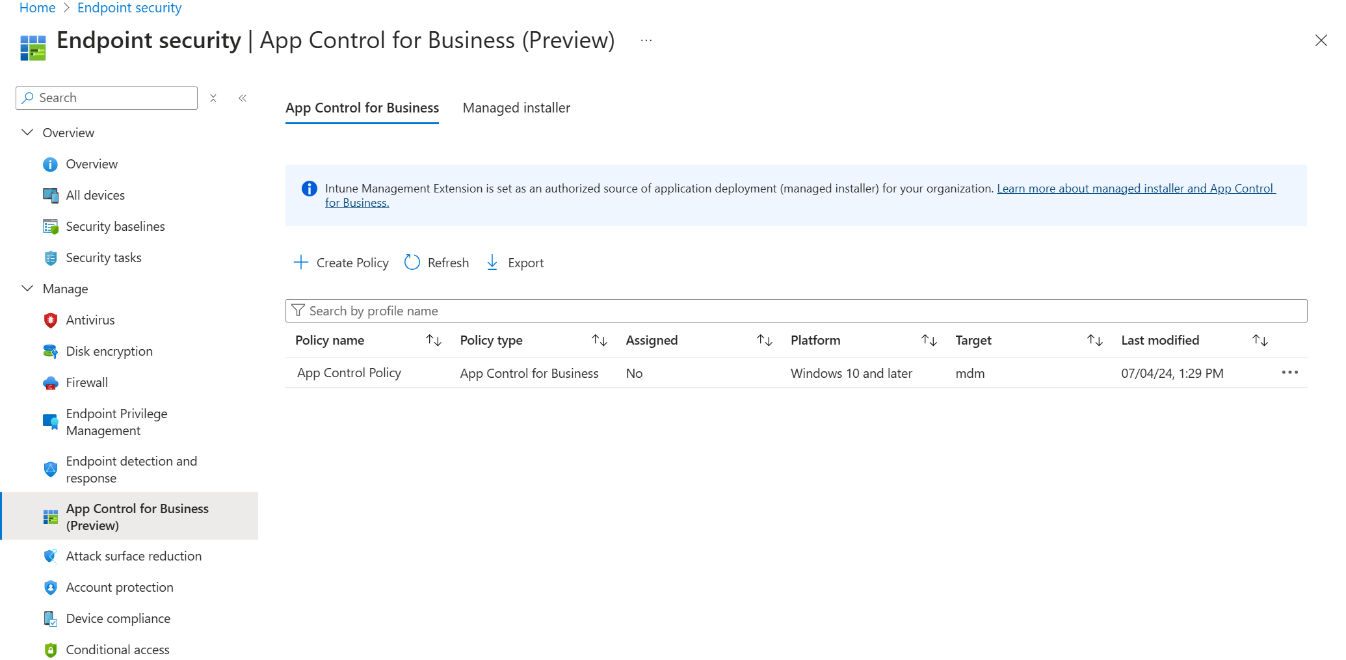
Creating App Control for Business policies
Notes:
With Intune's endpoint security App Control for Business policies, you can manage which apps on your managed Windows devices are allowed to run. Any apps that aren't explicitly allowed to run by a policy are blocked from running unless you've configured the policy to use an Audit mode. With audit mode, the policy allows all apps to run and logs the details about them locally on the client.

Slide 15
Getting started with App Control for Business policies
Using built-in controls
Enable trust of Windows components and store apps
Trust apps with a good reputation
Trust apps from managed installers
Enter xml data
For custom properties definition
Use built-in controls for easy configuration
App Control Wizard!

Slide 16
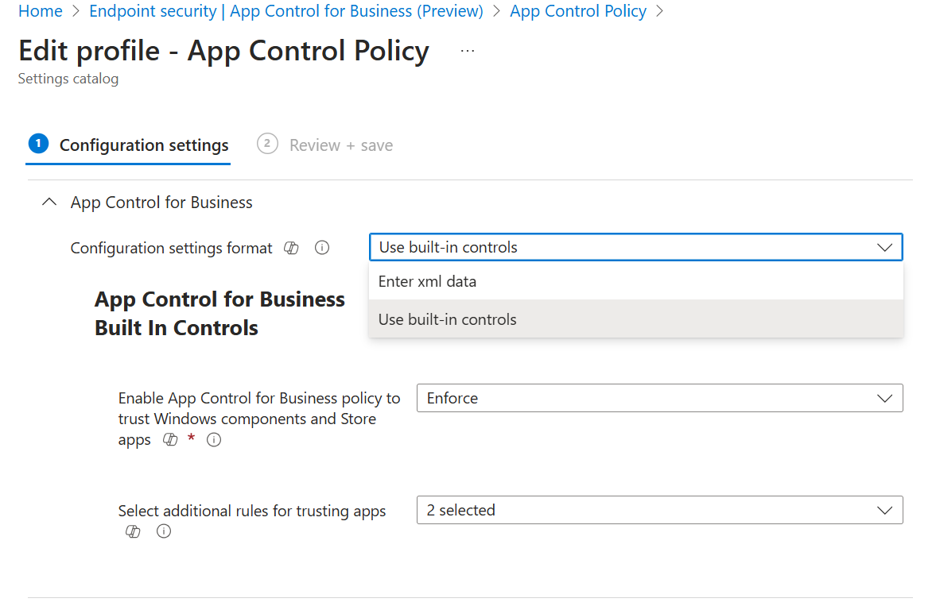
Getting started with App Control for Business policies

Slide 17
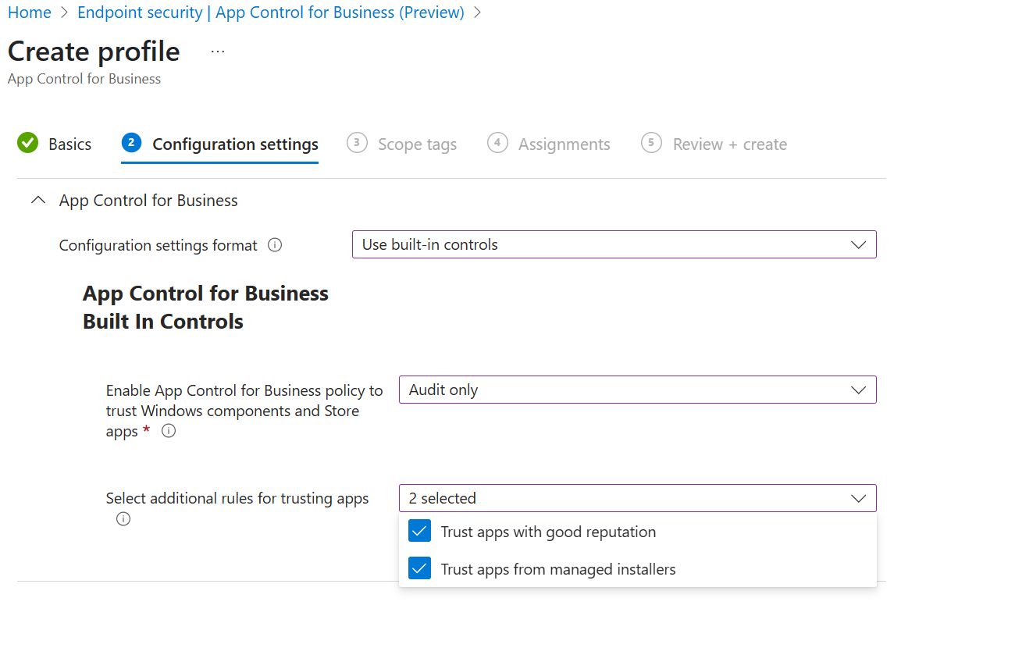
Getting started with App Control for Business policies

Slide 18
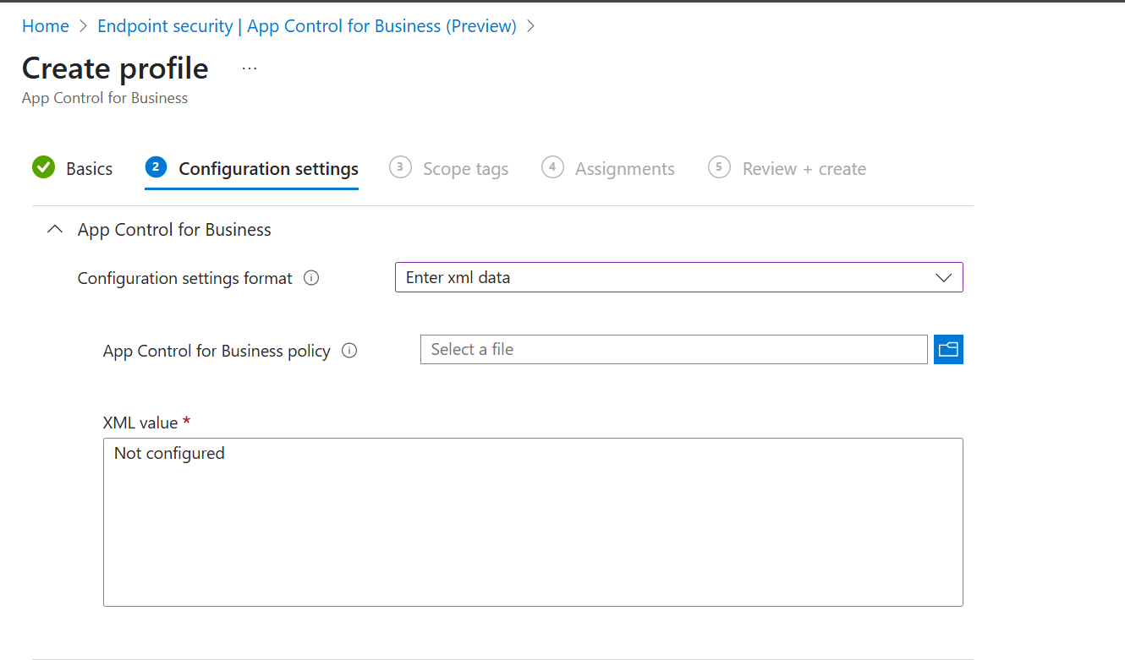
Getting started with App Control for Business policies

Slide 19
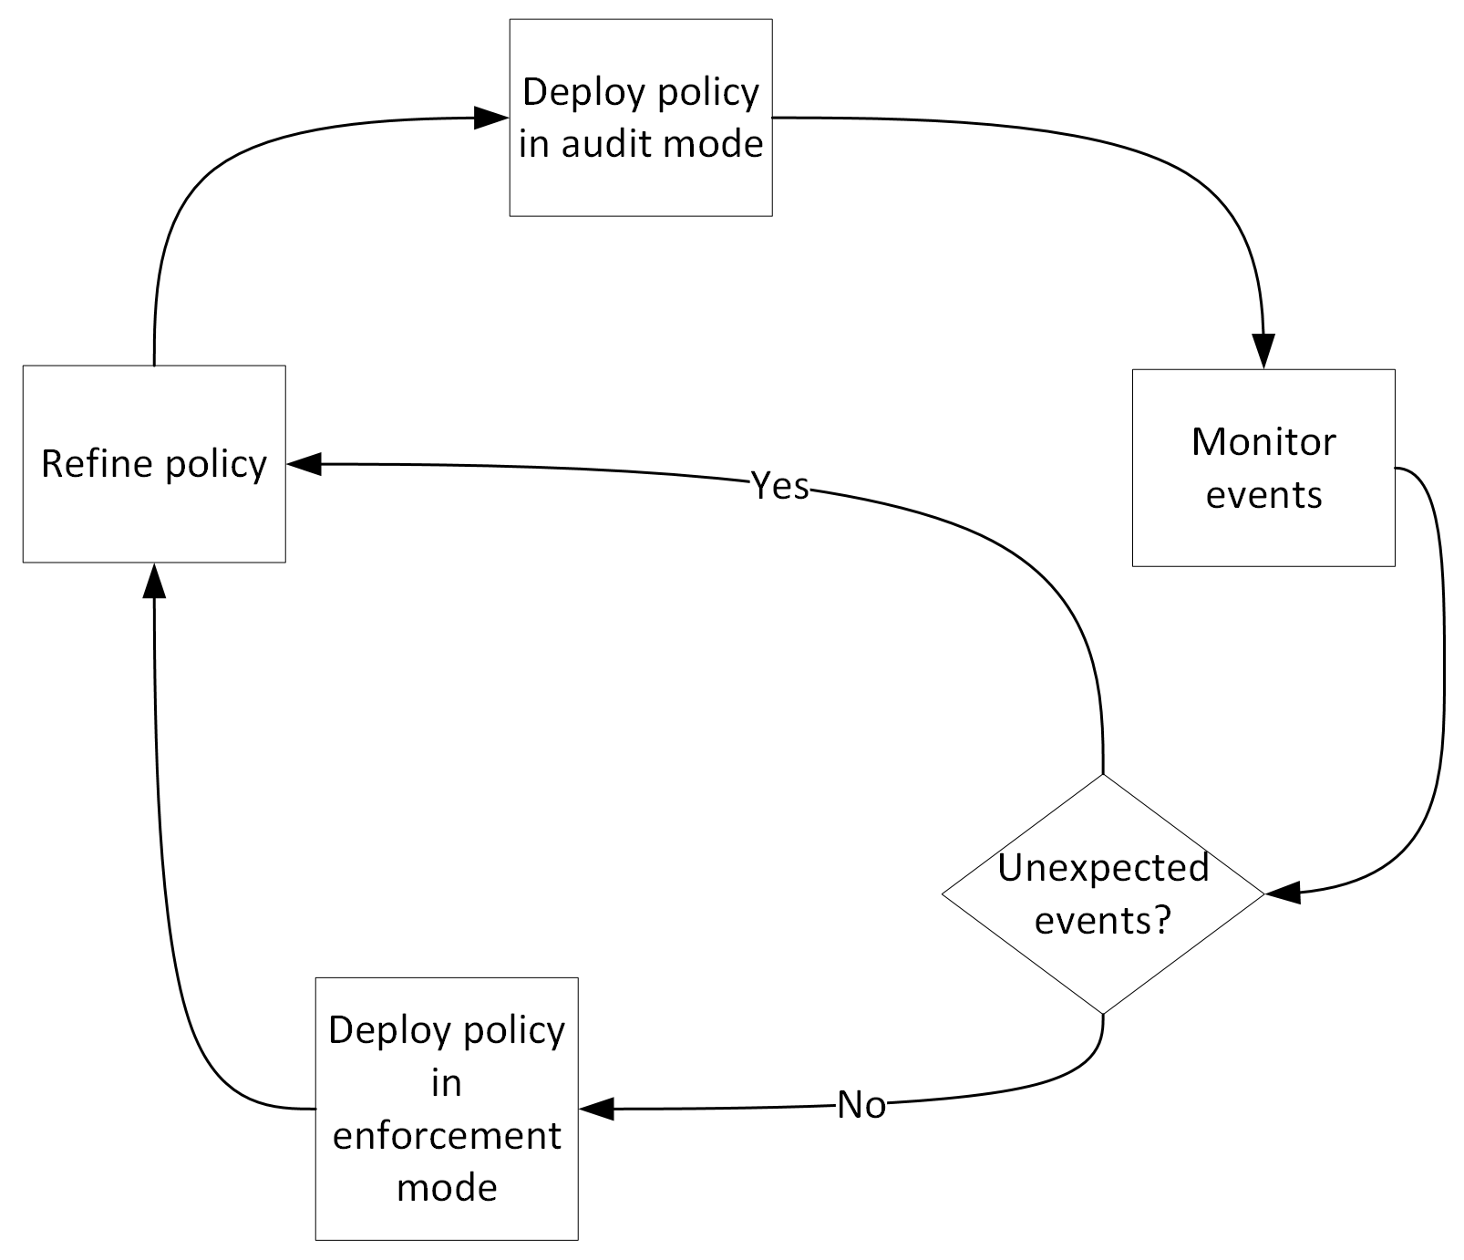
Creating the XML

Slide 20
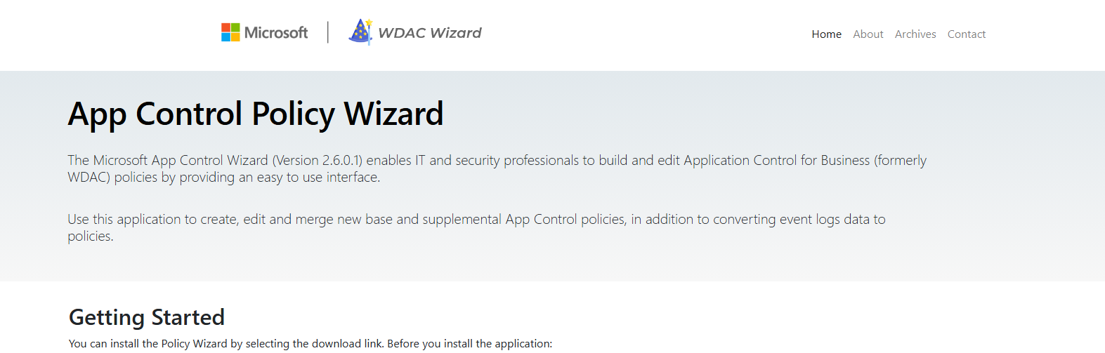
App Control Policy Wizard

Slide 21
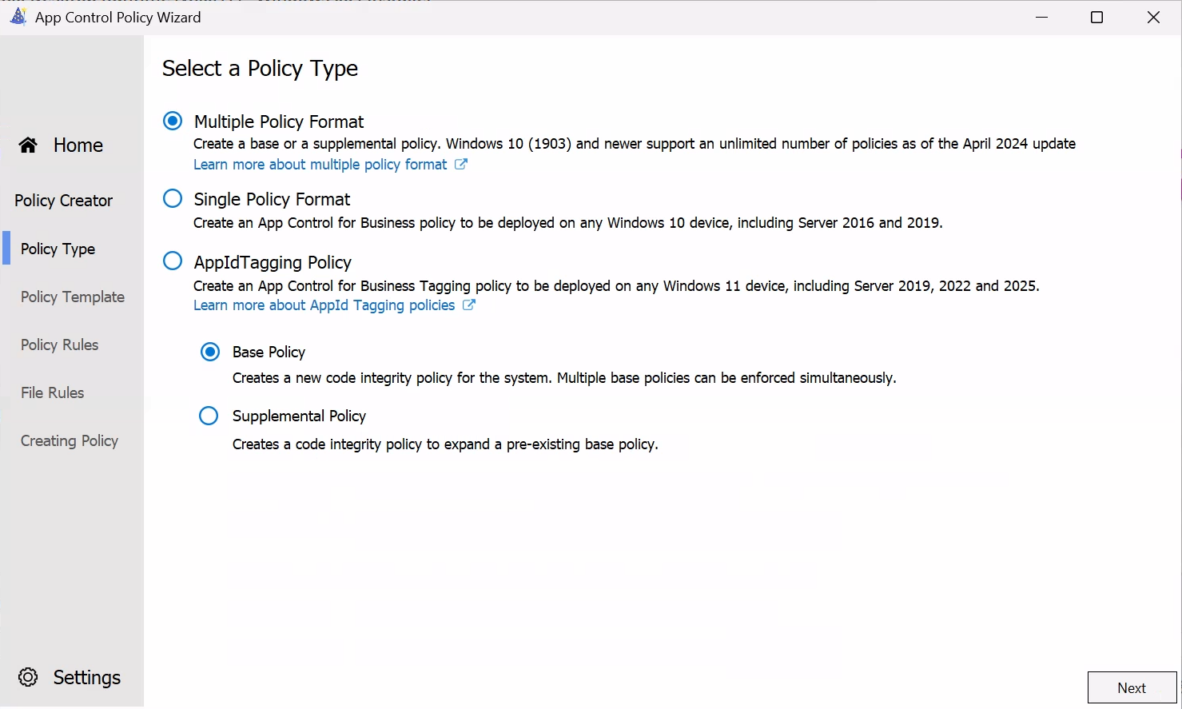
Creating a Base Policy
Notes:
TODO: Overview of options in App Control Policy Wizard
Base Policy

Slide 22
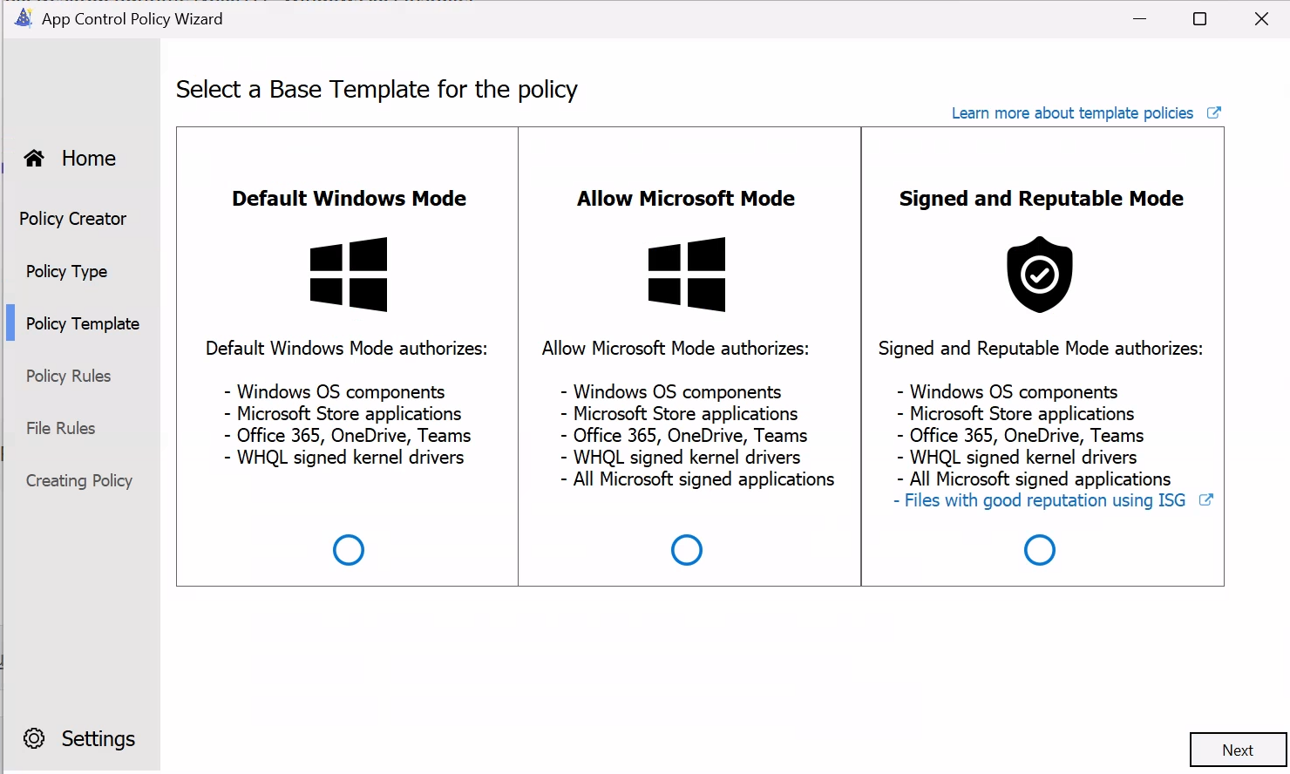

Slide 23
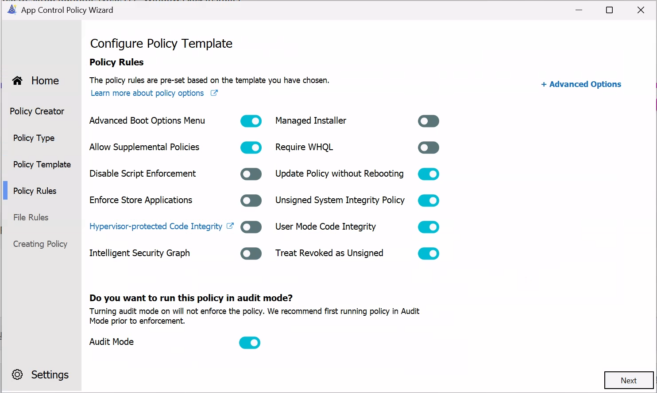

Slide 24
Using a supplemental policy
Policy Expansion
Enhances base policy to include more trusted applications
Multiple Supplementals for One Base Policy
Allows various apps for different teams

Slide 25
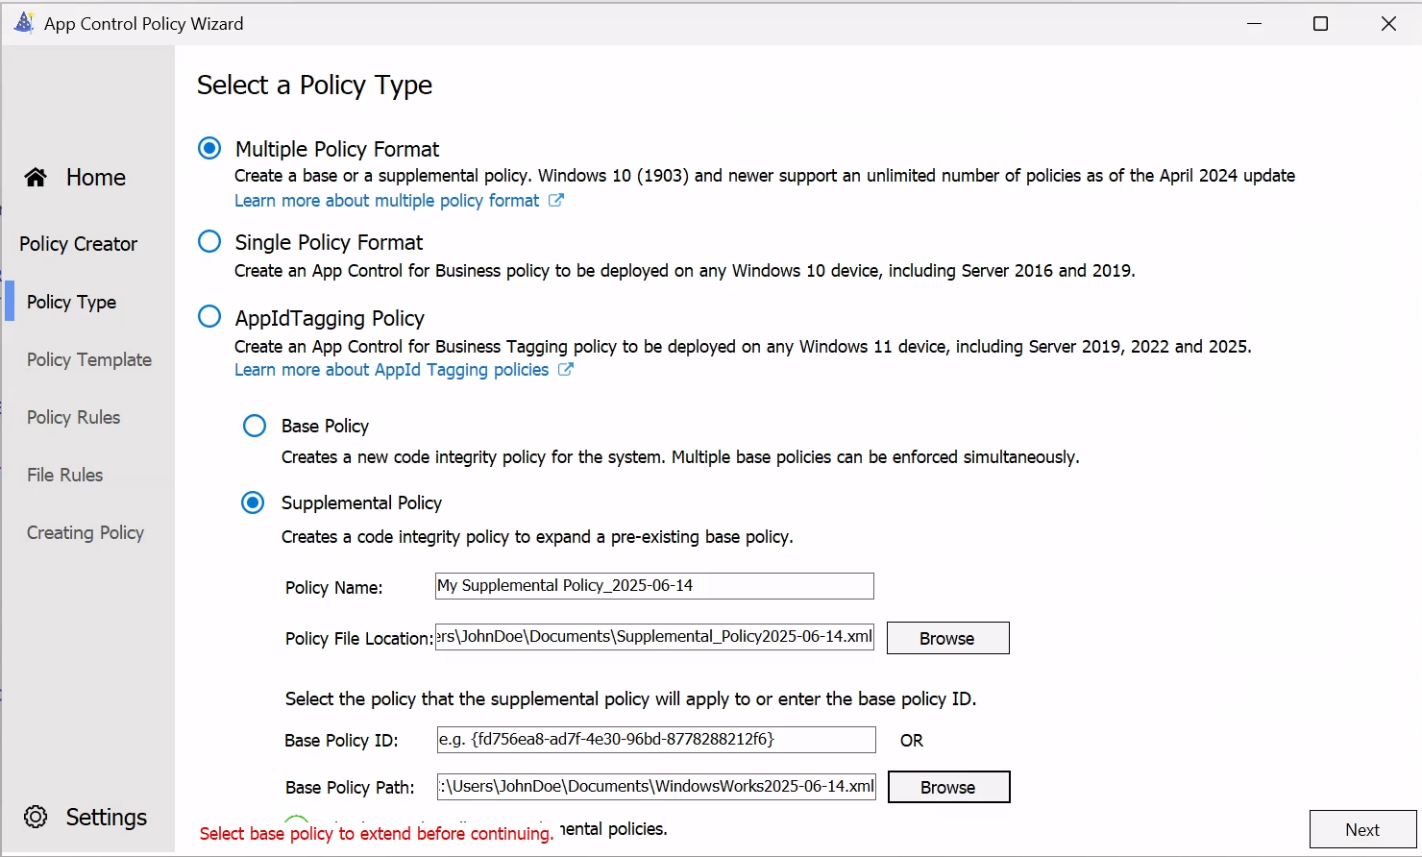
Creating a Supplemental Policy
Notes:
Overview of two policy types in WDAC Wizard
Supplemental Policy

Slide 26
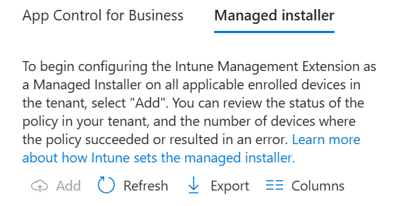
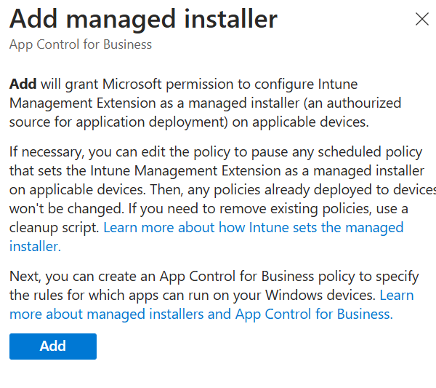
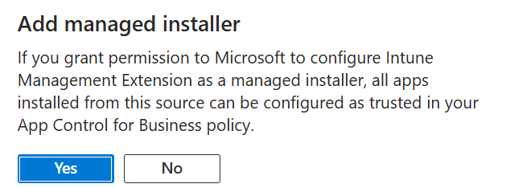
Using a Managed Installer

Slide 27
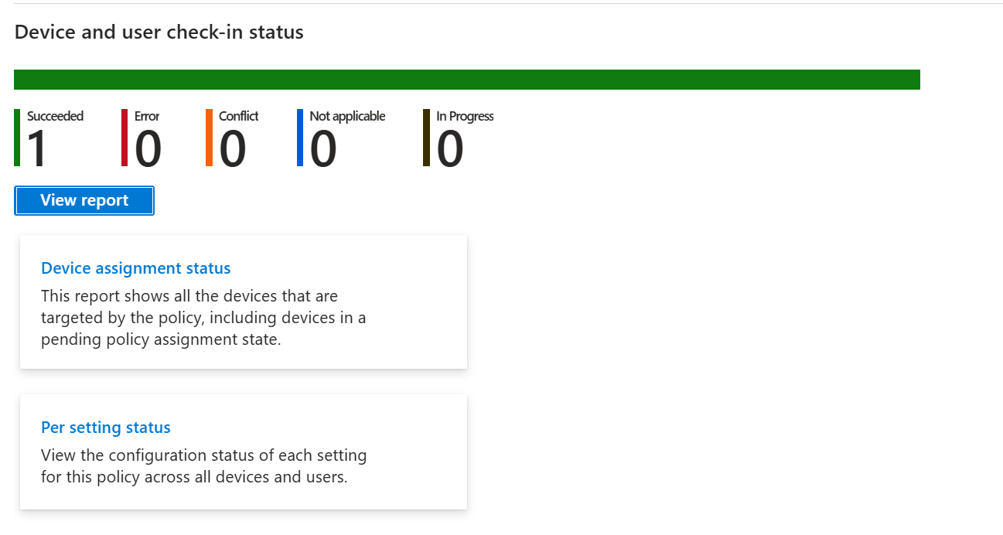
Monitoring App Control for Business policies
Verify the status of the policy assignment
Verify the status of the Managed Installer

Slide 28
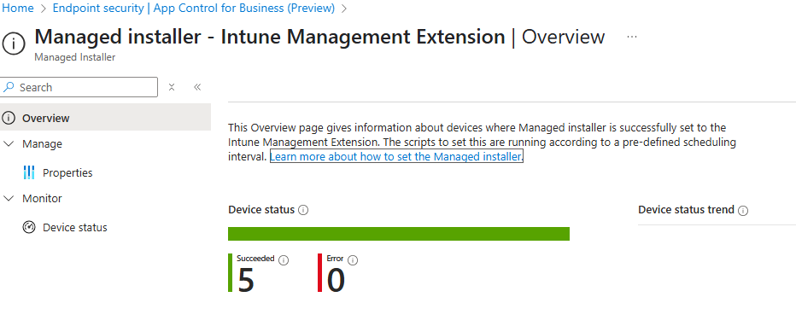
Monitoring App Control for Business policies
Verify the status of the policy assignment
Verify the status of the Managed Installer
What about the audit mode logs locally on the client?

Slide 29
Troubleshooting from the endpoint
Using Registry
PowerShell
File Explorer
Event Viewer
Intune Management Extension logs
KQL (Device Query)

Slide 30
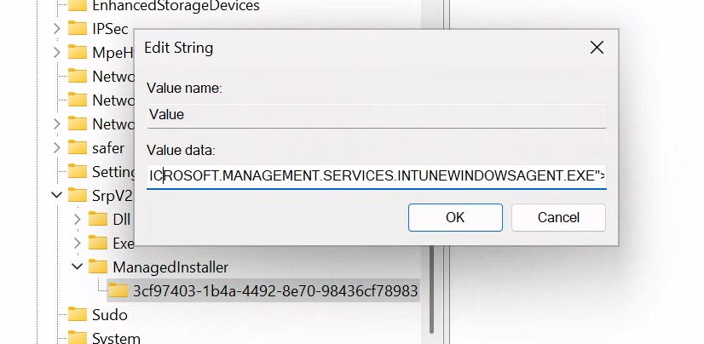
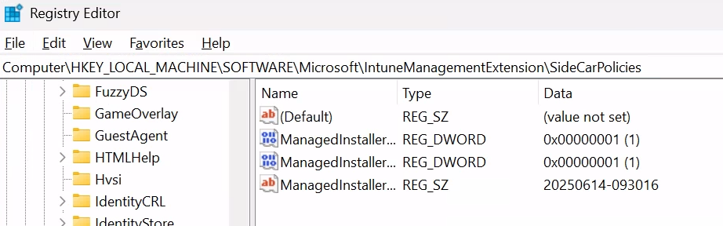
Troubleshoot using the Registry
Check if the Intune Management Extension is set as a Managed Installer
Computer\HKEY_LOCAL_MACHINE\SOFTWARE\Microsoft\IntuneManagementExtension\SideCarPolicies
ManagedInstallerEnabled = 1
Verify that the Managed Installer policy from Intune delivered
Computer\HKEY_LOCAL_MACHINE\SOFTWARE\Policies\Microsoft\Windows\SrpV2\ManagedInstaller

Slide 31
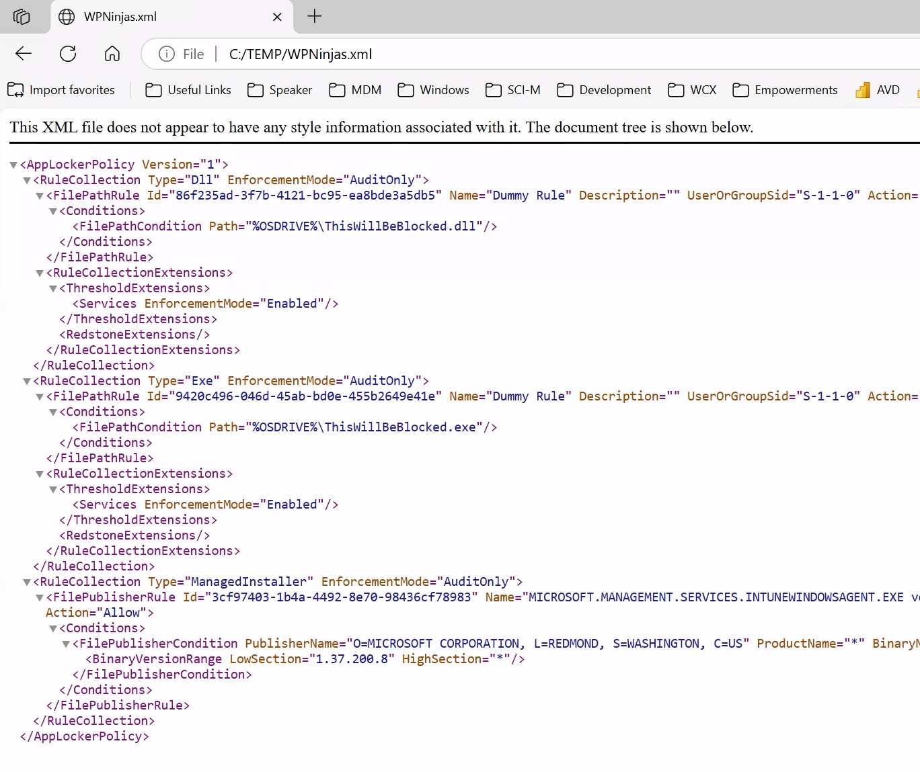
Troubleshoot using PowerShell
Export the details of the AppLocker policy to an XML file
Get-AppLockerPolicy -Effective -Xml | Set-Content ("C:\TEMP\WPNinjas.xml")

Slide 32
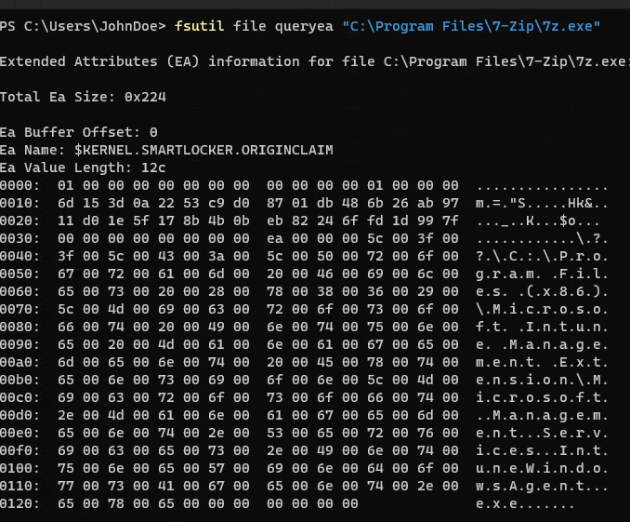
Troubleshoot using PowerShell
Verify the Managed Installer tag
Using fsutil.exe to query the Extended Attribute KERNEL.SMARTLOCKER.ORIGINCLAIM
If the output shows "00" in the fifth position of the data, it indicates that the Extended Attribute is related to a Managed Installer.
Notes:
TODO
Fsutil.exe file queryEA “C:\Program Files\7-Zip\”
Using fsutil.exe to query the Extended Attributes (EAs) on a file/app installed by IME and check for the KERNEL.SMARTLOCKER.ORIGINCLAIM EA.
From the output shown below, find the first row of data labeled "0000:", which is then followed by 16 two-character sets. Every four set form a group known as a ULONG.
If there is "00" in the fifth position of the output (the start of the second ULONG), that indicates the EA is related to managed installer.
A value of "00" means the file was directly written by a managed installer process and will run if your Application Control policy trusts managed installers.

Slide 33
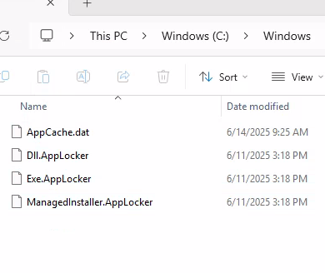
Troubleshoot using File Explorer
Managed Installer location
C:\Windows\System32\AppLocker

Slide 34
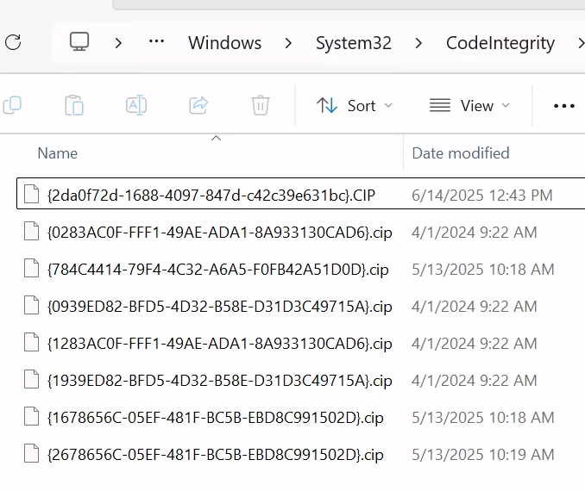
Troubleshoot using File Explorer
Policy location
C:\Windows\System32\CodeIntegrity\CiPolicies\Active
Notes:
TODO

Slide 35
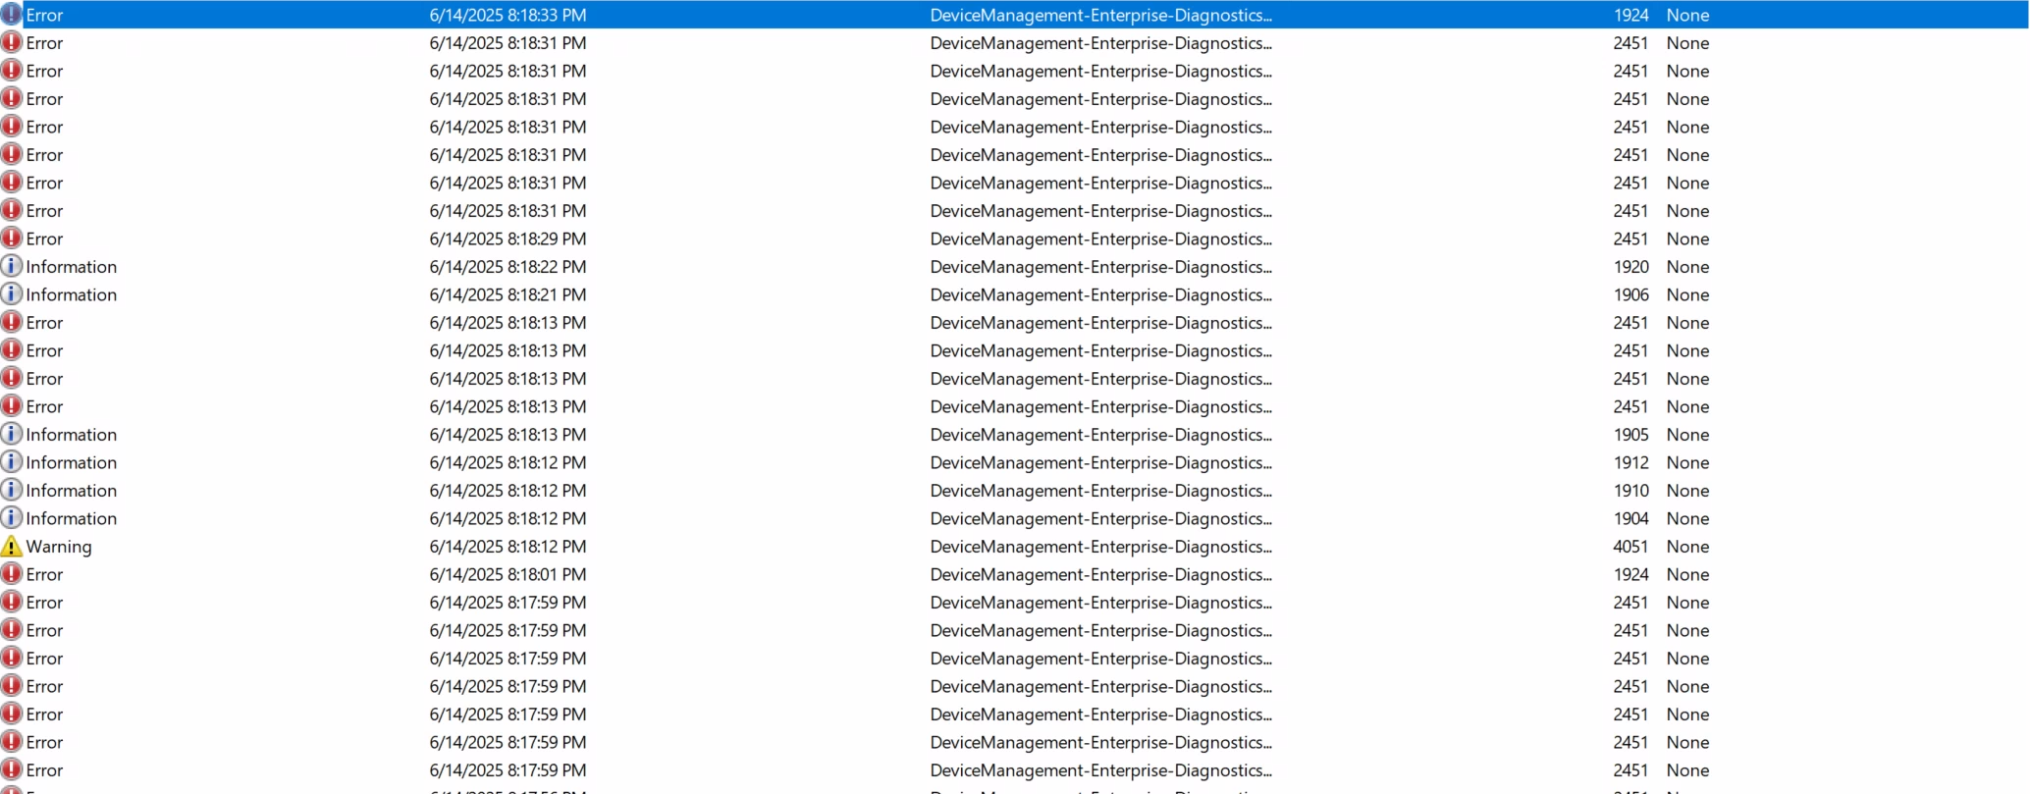
Troubleshoot using the Event Viewer
Applications and Services Logs > Microsoft > Windows > DeviceManagement-Enterprise-Diagnostics-Provider > Admin
Event ID 814/815: Indicates MDM policy download and application status
Understanding App Control event IDs | Microsoft Learn
Notes:
Generally, see what policies are getting into the device

Slide 36
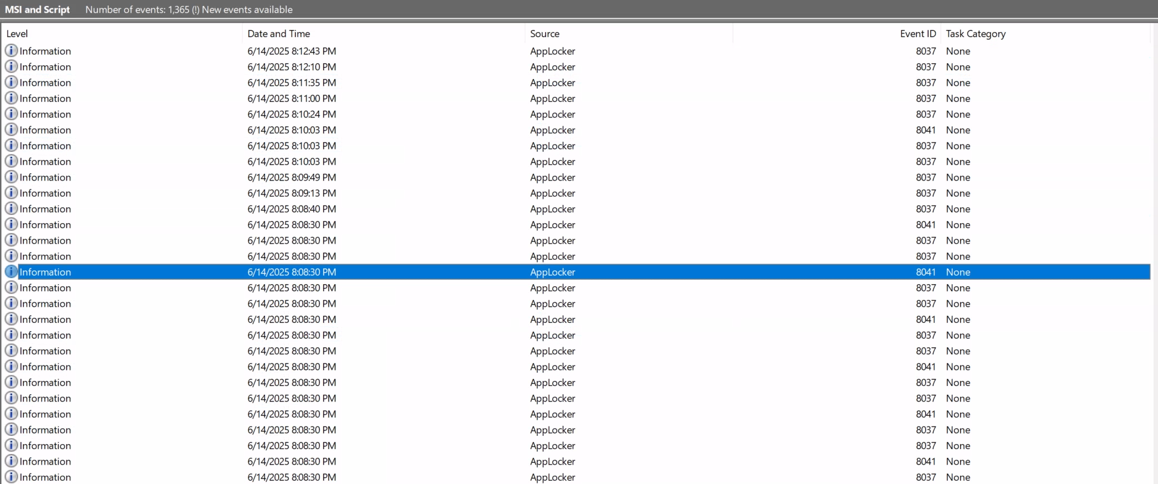
Troubleshoot using the Event Viewer
Applications and Services logs - Microsoft - Windows - AppLocker - MSI and Script
Event ID 8039: Indicates that a packaged app was allowed to install or run because the policy is in audit mode. But it would have been blocked if the policy had been enforced.
Event ID 8040: Indicates that a packaged app was prevented from installing or running due to the policy.
Understanding App Control event IDs | Microsoft Learn
Notes:
Generally see what policies are getting into the device

Slide 37
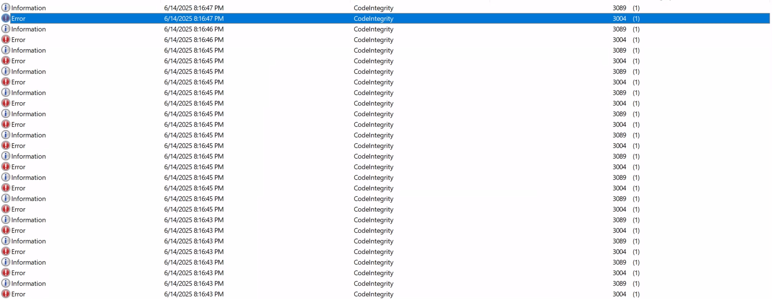
Troubleshoot using the Event Viewer
Applications and Services logs > Microsoft > Windows > CodeIntegrity > Operational
Event ID 3105: The system is attempting to refresh the Application Control policy with the specified policy ID
Event ID 3102: The system finished refreshing the Application Control policy.
Understanding App Control event IDs | Microsoft Learn
Notes:
Generally see what policies are getting into the device

Slide 38
Troubleshoot using the Event Viewer
Applications and Services logs > Microsoft > Windows > CodeIntegrity > Operational
Event ID 3076: AppControlCodeIntegrityPolicyAudited: Indicates the file would have been blocked if the policy was enforced.
Event ID 3077: AppControlCodeIntegrityPolicyBlocked: Indicates the file didn't pass your WDAC policy and was blocked.
Event ID 3091: Indicates that a file didn't have managed installer authorization, and the policy is in audit mode.
Event ID 3099: Indicates that a policy has been loaded. This event also includes information about the options set by the Application Control policy.
Understanding App Control event IDs | Microsoft Learn
Notes:
Generally see what policies are getting into the device

Slide 39
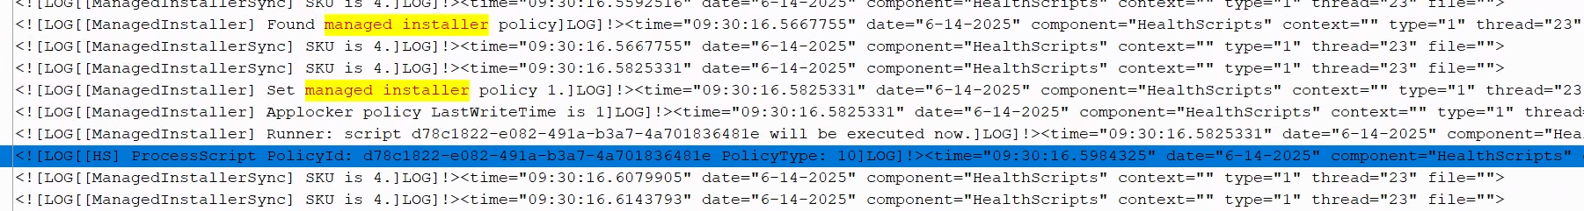
Troubleshoot using the Intune Management Extension logs
Open the HealthScripts log file.
C:\ProgramData\Microsoft\IntuneManagementExtension\Logs
Look for the Managed Installer policy ID
d78c1822-e082-491a-b3a7-4a701836481e

Slide 40
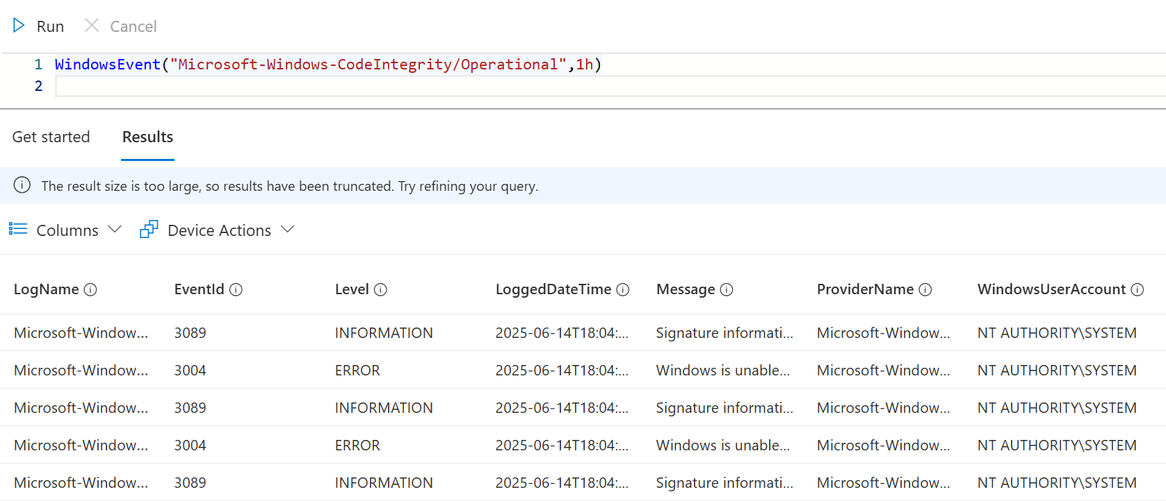
Troubleshoot using KQL (Device Query)
WindowsEvent("Microsoft-Windows-CodeIntegrity/Operational",1h) | where EventId == 3004

Slide 41
Best Practices for App Control for Business
Deploy Managed Installer first so that apps can start getting the Managed Installer tag.
That way, if later you are ready to deploy App Control policy, you can use “Trust apps from managed installer” rule without having to redeploy apps.
1
When the admin completes opt-in for a tenant, ensure caching time has passed.
Any change to add and remove the AppLocker policy could take up to an hour to be effective on the device.
2
In terms of App Control policy, use audit mode first and then switch to enforce mode. - Audit mode will allow you to monitor the app behavior and block events without affecting the end user experience. - Enforce mode will enforce the app allow list and block any apps that are not allowed.
3
Intune just helps facilitate the App Control policy deployment and reporting. The actual app behavior and block events are handled by Windows and Defender.
Therefore, it is important to understand the App Control for Business feature and how it works with AppLocker and Managed Installer.

Slide 42
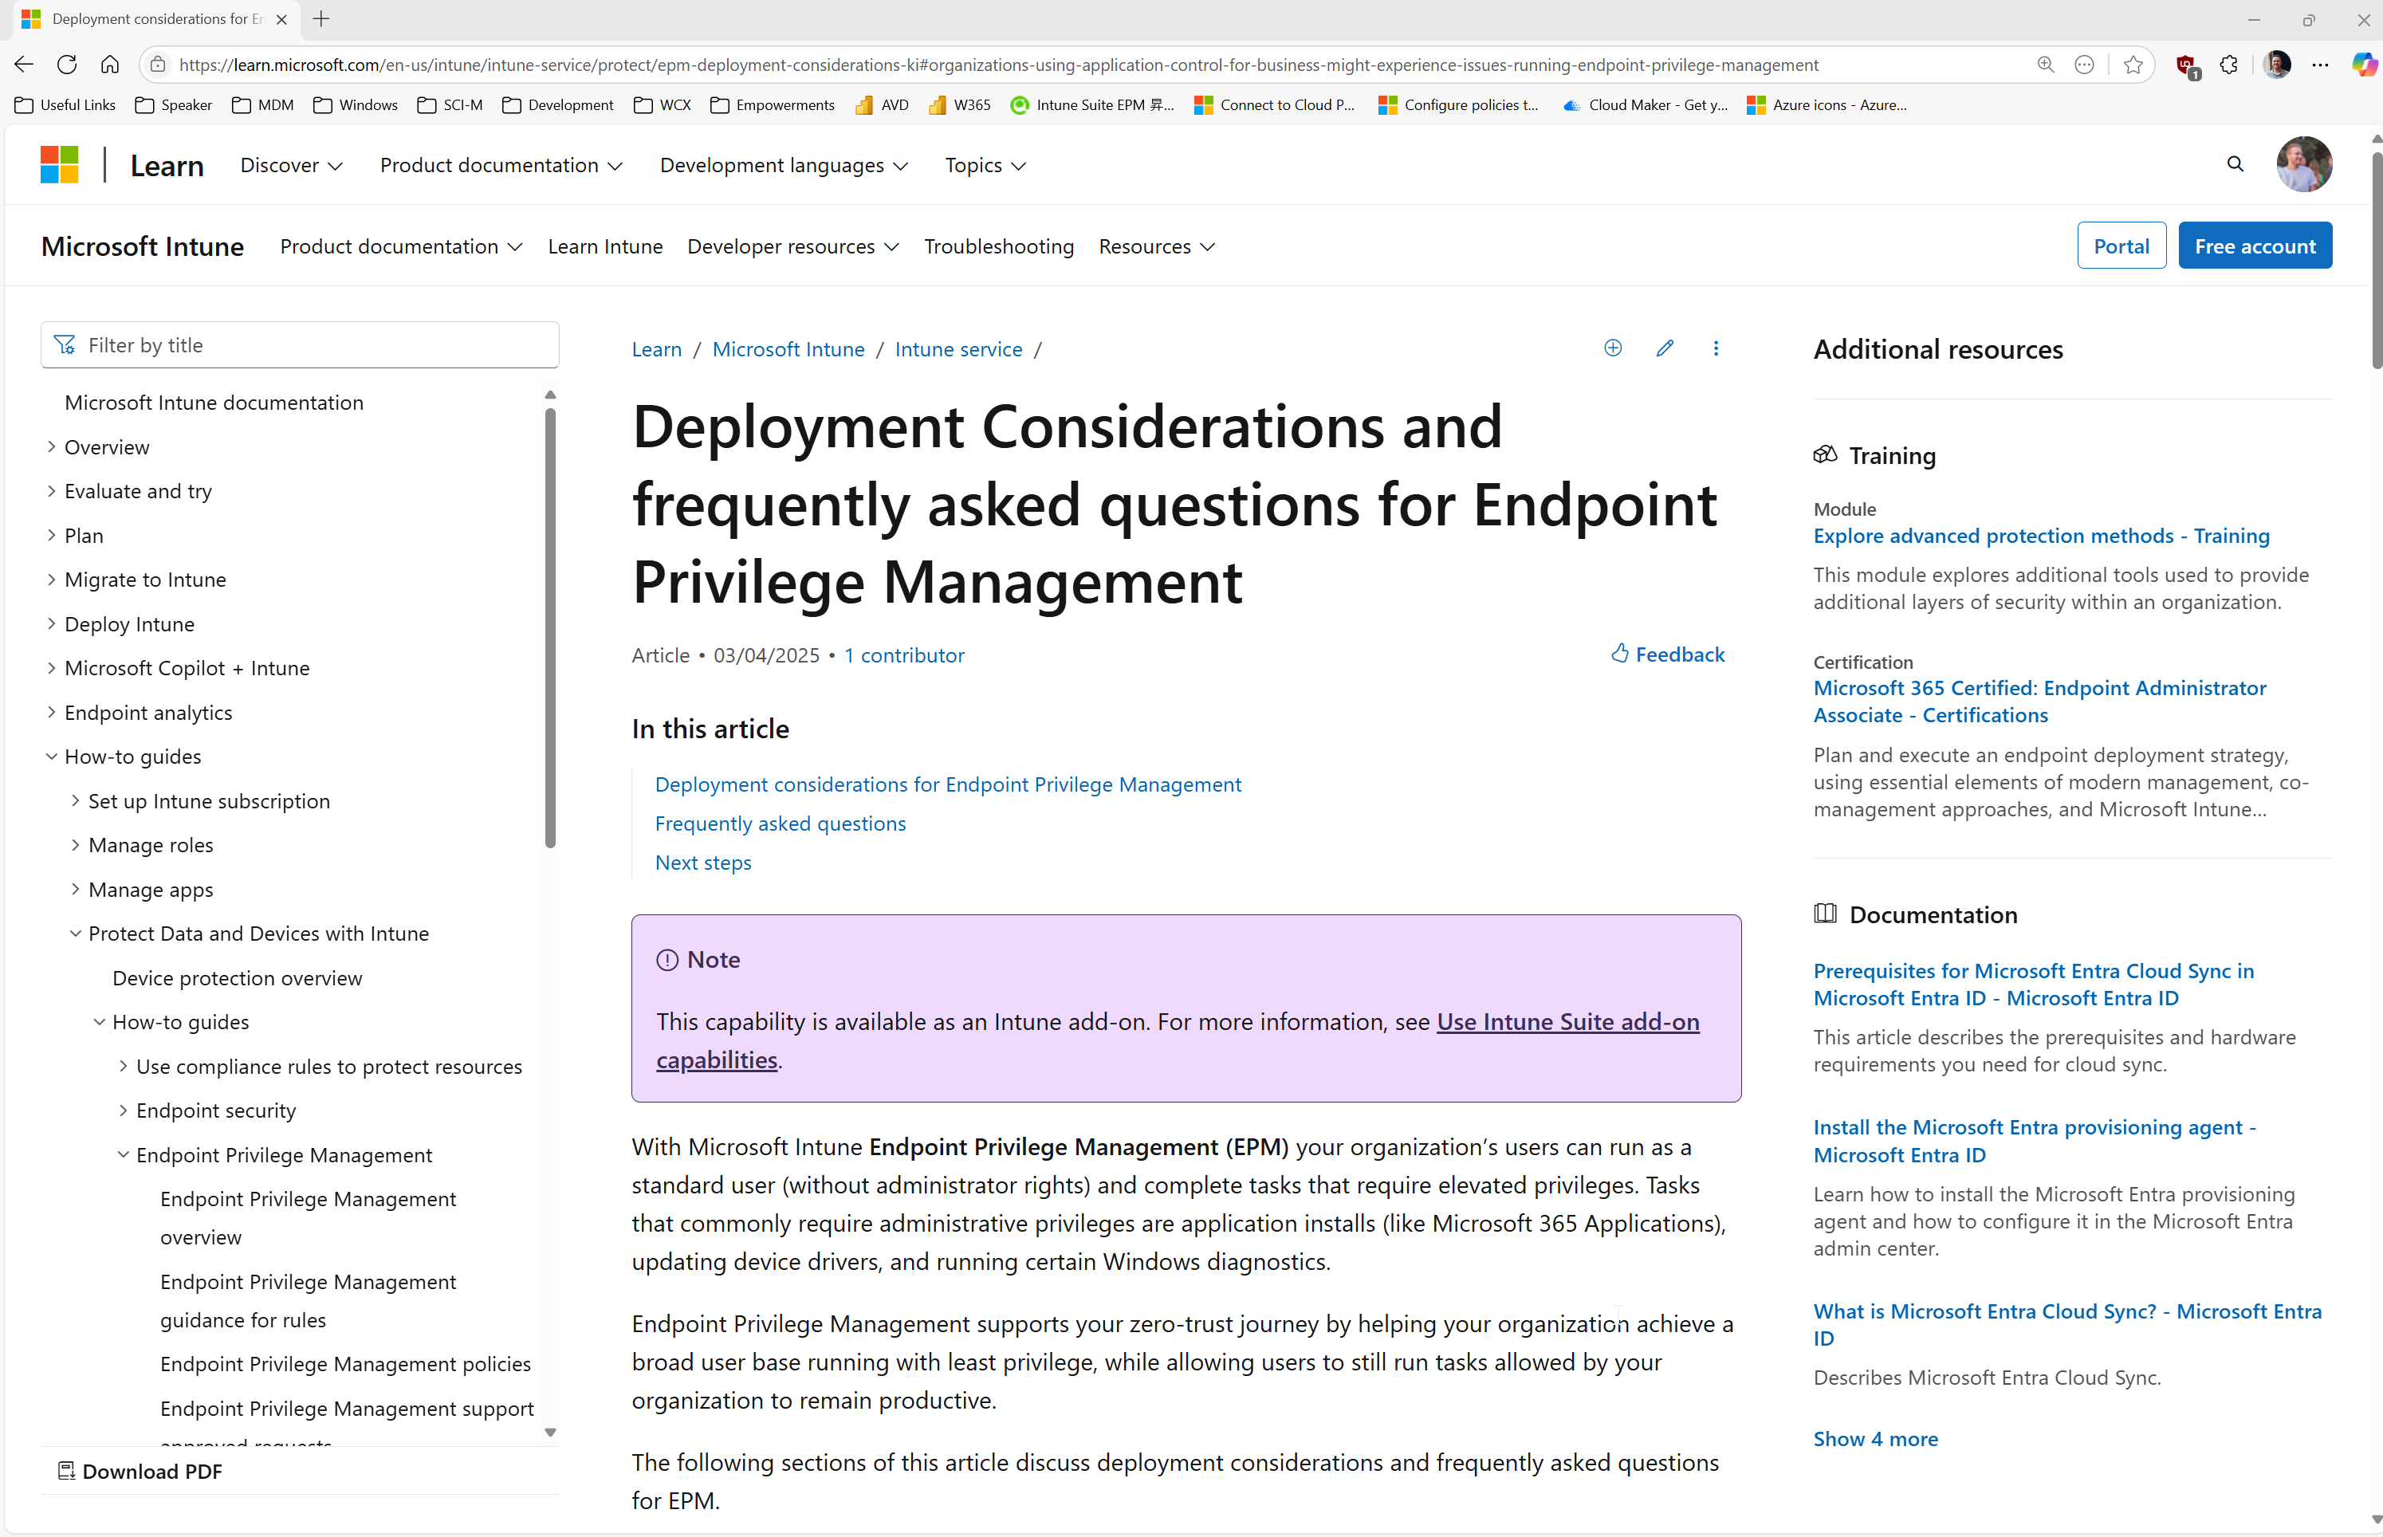
Deployment considerations for Endpoint Privilege Management
What can go wrong…
Notes:
Deployment considerations for Endpoint Privilege Management | Microsoft Learn

Slide 43
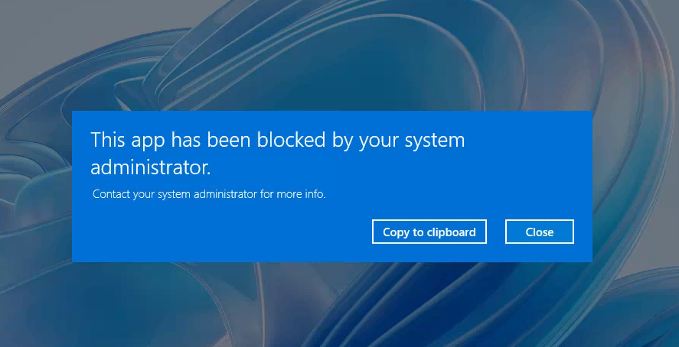
Monitoring the impact of EPM on App Control for Business

Slide 44
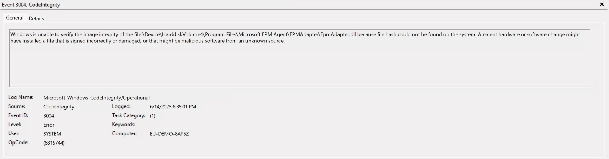
Monitoring the impact of EPM on App Control for Business

Slide 45
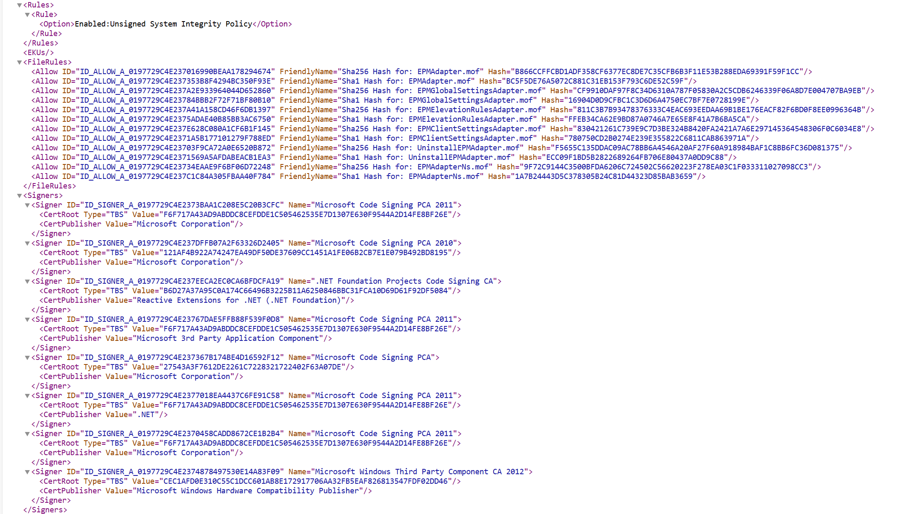
Remediating the impact of EPM
Creating a Supplemental Policy on top of your Base Policy!

Slide 46
Creating the XML

Slide 47
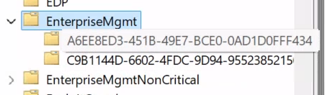
Troubleshooting EPM – Confirm Dual Enrollment
Task Scheduler > Microsoft > Windows > EnterpriseMgmt > EnterpriseMgmt
2 GUIDs should be visible
Notes:
Verify EPM client enrollment state:
Task Scheduler > Microsoft > Windows > EnterpriseMgmt > expand EnterpriseMgmt > If you see two GUIDs your devices are enrolled.
Note it can take up to 15 minutes.

Slide 48
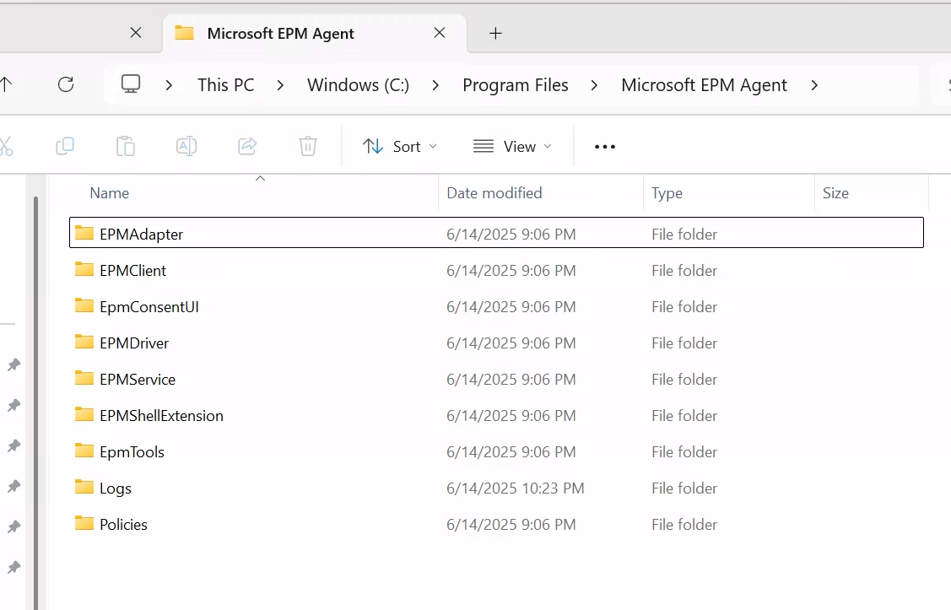
Troubleshooting EPM – Check the files
Notes:
Check EPM client installation folder
C:\Program Files\Microsoft EPM Agent

Slide 49
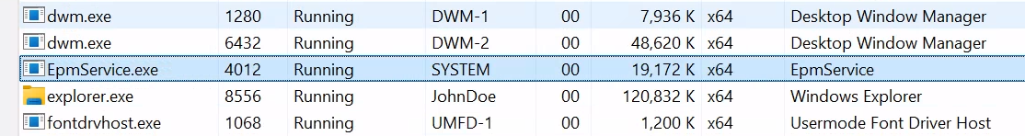
Troubleshooting EPM – Verify the EPM Service
Open Task Manager
Verify EPM Service
Notes:
Validate EPM Service is running.
Open Task Manager > verify EPM Service is running.

Slide 50
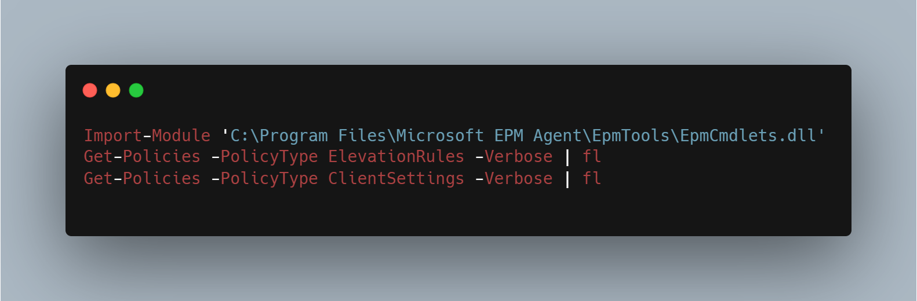
Troubleshooting EPM - PowerShell
Notes:
Validate your EPM policy has been received and processed.
Navigate to c:\program files\microsoft EPM agent\epmtools
Open the readme.txt file for directions on how to use the EPM PowerShell Module

Slide 51
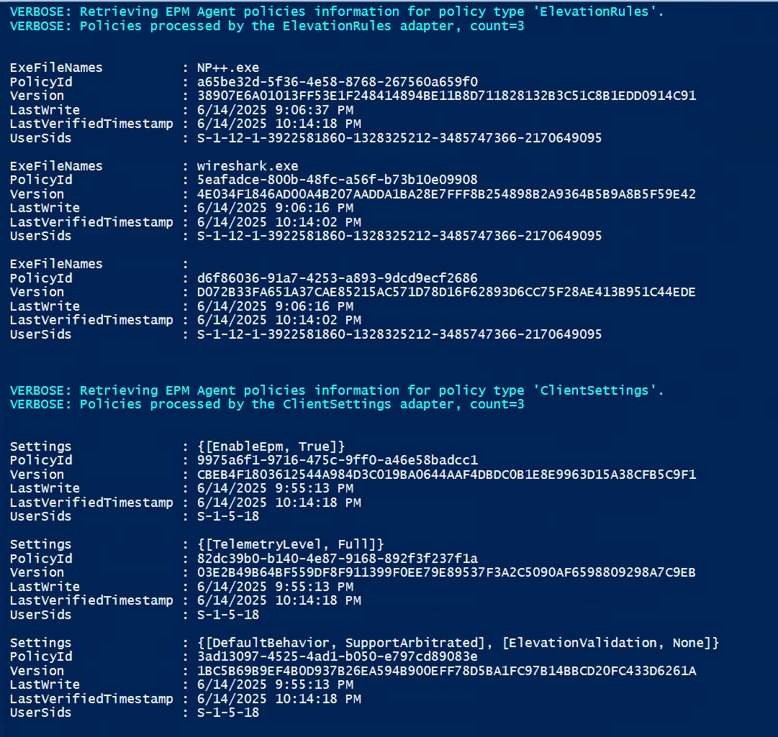
Troubleshooting EPM - PowerShell
Notes:
Validate your EPM policy has been received and processed.
Navigate to c:\program files\microsoft EPM agent\epmtools
Open the readme.txt file for directions on how to use the EPM PowerShell Module

Slide 52
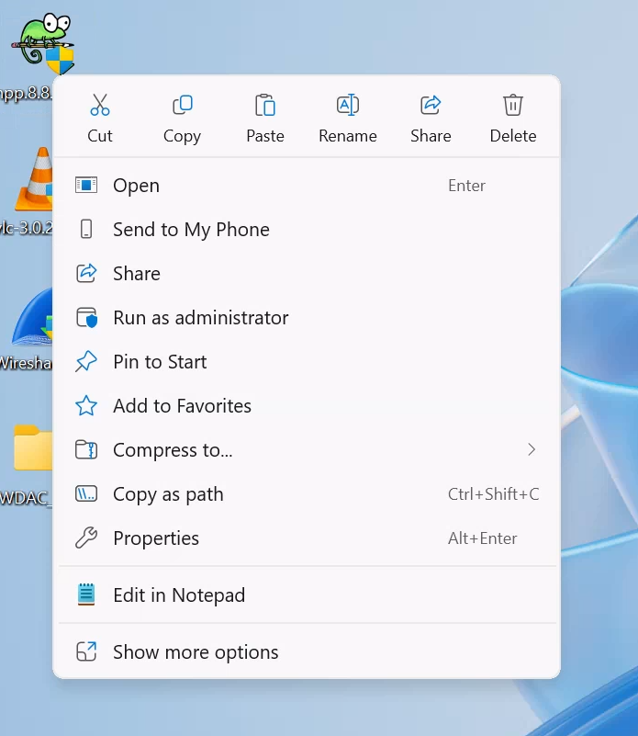
We’re not in Kansas anymore…

Slide 53
Possible future solutions?
Disable App Control?
Disable EPM?
Have the option to add EPM as a Managed Installer in Intune?

Slide 55
PLATINUM
GOLD
SILVER
SPONSORS
EVENT PARTNERS

